Slide 1
SOFA BDD
© 2013 Armando Fox & David Patterson, all rights reserved

Slide 2
Outline
9.5 Identifying What’s Wrong: Smells, Metrics, SOFA
9.4 Comments
7.1 Intro to BDD & User Stories
7.2 Points, Velocity, and Pivotal Tracker
7.3 SMART User Stories
7.4 Lo-Fi User Interface Sketches and Storyboards
7.5 Agile Cost Estimation
7.10 Plan-and-Document Perspective

Slide 3
END

Slide 4

Identifying What’s Wrong: Smells, Metrics, SOFA (ESaaS §9.5)
http://pastebin.com/gtQ7QcHu
© 2012 Armando Fox & David Patterson
Licensed under Creative Commons Attribution-NonCommercial-ShareAlike 3.0 Unported License

Slide 5
Beyond Correctness
Can we give feedback on software beauty?
Guidelines on what is beautiful?
Qualitative evaluations?
Quantitative evaluations?
If so, how well do they work?
And does Rails have tools to support them?

Slide 6

Qualitative: Code Smells
SOFA captures symptoms that often indicate code smells:
Is it Short?
Does it do One thing?
Does it have Few arguments?
Is it a consistent level of Abstraction?
Rails tool reek finds code smells
Notes:
Code smell alerts you that something may be wrong
20 to 60 different code smells depending on authority
Could spend several lectures on them, but just give an idea now
Methods that don’t follow this advice will often give off several of the smells
Short – depends on language (More than 1 screenful for old 24x80 monitors) – try to do one thing, be able to look at method and quickly understand it
One thing – method may just call a bunch of other methods to do this

Slide 7
Single Level of Abstraction
Complex tasks need divide & conquer
Yellow flag for “encapsulate this task in a method”
Like a good news story, classes & methods should read “top down”!
Good: start with a high level summary of key points, then go into each point in detail
Good: Each paragraph deals with 1 topic
Bad: ramble on, jumping between “levels of abstraction” rather than progressively refining
Notes:
Concentrate on Abstraction since violating it rapidly makes your code start to make ugly, correlates well with other smells
Divide and Conquer: Don’t have one method that does everything. Divide into understandable pieces, and have methods call others – I once had a main() routine that grew to >3000 lines of code! Suffered from common problem – feature creep
Have a method that orchestrates all the work
Symptom – 1 line of code says what to do, many lines of code around it saying how to do it
One of other SOFA is too many arguments – have had methods with 20+ arguments

Slide 8
Why Lots of Arguments is Bad
Hard to get good testing coverage
Hard to mock/stub while testing
Boolean arguments should be a yellow flag
If function behaves differently based on Boolean argument value, maybe should be 2 functions
If arguments “travel in a pack”, maybe you need to extract a new class
Same set of arguments for a lot of methods
Notes:
If behavior really depends on lots of arguments, then lots to test
Also makes it hard to mock/stub if many args interact
Boolean – made 1 method harder to test than 2 methods

Slide 9
Program X & Smells
class TimeSetter
def self.convert(d)
y = 1980
while (d > 365) do
if (y % 400 == 0 ||
(y % 4 == 0 && y % 100 != 0))
if (d > 366)
d -= 366
y += 1
end
else
d -= 365
y += 1
end
end
return y
end
end
time_setterTimeSetter#self.convert calls (y + 1) twice (Duplication)
.rb -- 5 warnings
TimeSetter#self.convert calls (y + 1) twice (Duplication)
TimeSetter#self.convert has approx 6 statements (LongMethod)
TimeSetter#self.convert has the parameter name 'd' (UncommunicativeName)
TimeSetter#self.convert has the variable name 'd' (UncommunicativeName)
TimeSetter#self.convert has the variable name 'y‘ (UncommunicativeName)
Notes:
A little Ruby goes a long way; if you stare at it a long time and can’t figure it out, its too long
Not DRY (y+1)
Uncommunicative variable names
- Suppose Hebrew calendar, suppose not Gregorian

Slide 10
Quantitative: ABC Complexity
Counts Assignments, Branches, Conditions
Complexity Score = √(A² ⁺ B² ⁺ C²)
NIST (Natl. Inst. Stds. & Tech.): ≤20/method
Rails tool flog checks ABC complexity
Notes:
Branching terms are :and, :case, :else, :if, :or, :rescue, :until, :when, :while
NIST – reference standards, e.g. the keeper of the second, meter, kilogram; standards for federal government contracts

Slide 11
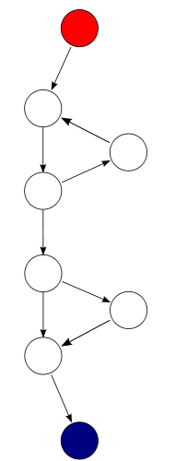
Quantitative: Cyclomatic Complexity
# of linearly-independent paths thru code = E–N+2P (edges, nodes, connected components)
def mymeth
while(...)
....
end
if (...)
do_something
end
end
Here, E=9, N=8, P=1, so CC=3
NIST: ≤10/module
Rails tool saikuro calculates cyclomatic complexity (CC)
Notes:
A graphical measurement of the number of possible paths through the normal flow of a program
Node is basic block
Connected components
Also called McCabe Complexity, after the inventor

Slide 12
Quantitative: Metrics
Metric | Tool | Target score
Code-to-test ratio | rake stats | ≤ 1:2
C0 (statement) coverage | SimpleCov | 90%+
ABC score | flog | < 20/method (NIST)
CC score | saikuro | < 10/method (NIST)
“Hotspots”: places where multiple metrics raise red flags
add require 'metric_fu' to Rakefile
rake metrics:all
Take metrics with a grain of salt
Like coverage, better for identifying where improvement is needed than for signing off
Notes:
Several tools point to difficulties than get your attention

Slide 13
Leap Year & Metrics
class TimeSetter
def self.convert(d)
y = 1980
while (d > 365) do
if (y % 400 == 0 ||
(y % 4 == 0 && y % 100 != 0))
if (d > 366)
d -= 366
y += 1
end
else
d -= 365
y += 1
end
end
return y
end
end
ABC score = 23
(> 20 so a problem)
CC score = 4
(≤ 10 so not a problem)

Slide 14
Revised Leap Year & Metrics
class TimeSetter
def self.convert(day)
year = 1980
while (day > 365) do
if leap_year?(year)
if (day >= 366)
day -= 366
end
else
day -= 365
end
year += 1
end
return year
end
private
def self.leap_year?(year)
year % 400 == 0 ||
(year % 4 == 0 && year % 100 != 0)
end
end
Reek: No Warnings
Flog (ABC):
TimeSetter.convert = 11
TimeSetter.leap_year? = 9
Saikuro (CC) = 5

Slide 15
END

Slide 16
Which SOFA guideline is most important for unit-level testing?
1.
Short
2.
Do One thing
3.
Have Few arguments
4.
Stick to one level of Abstraction
Notes:
Opinion vs. fact, so can make arguments for several, and could come up with counterexamples for specific programs why one is more important than the other
1. False. Long and straight-line could still be easy to test
2. False. If doing multiple things, but each is simple, could still be easy to test
3. True. The more arguments, the larger the input space, so the harder to test
(could be lot of args just go to one easy-to-test formula, OK, but probably should be own new class, that can test separately)
4. False. One level abstraction means easier to understand, but not necessarily easier to test

Slide 17
END

Slide 18
Good Comments
Comments Should Describe Things
That Aren’t Obvious From The Code:
Why, not What
(§9.4 ESaaS)
(from officemate John Ousterhout)
Notes:
* This means 2 things for writing comments:
* Don't just repeat what's obvious from the code
* Do think about what's not obvious (low level and high level):
* The units for variables, invariants
* Design issues that went through your mind while you were
writing the code: why the code is written this way.
* Subtle problems that required a particular implementation
* Abstractions:
* Goal is to write classes and other code that hides complexity:
easier to use than to write
* Abstractions won't be obvious from implementation; comments
should describe these (should be simple).
* For example, what do I need to know to invoke a procedure?
I shouldn't have to read the code of a procedure before calling
it.
* "Obvious" refers to someone who will come along later and read your
code, not you.
Must write comments as you code; if you come back later you will
have forgotten the design ideas, so comments will mimic the code.

Slide 19
Bad Comments
// Add one to i. i++;
// Lock to protect against concurrent access. SpinLock mutex;
// This function swaps the panels. void swap_panels(Panel* p1, Panel* p2) {...}
Notes:
* Most software is poorly documented
* A lot of code has no comments at all
* Many open source projects set a very bad example
* When present, comments often not helpful
* Many people think comments are a bad idea
* Not useful
* Out of date
* Clutter the code
* "Just let me read the code!"

Slide 20
Comments, cont’d
Comments should be at a higher abstract level than code:
# Scan the array to see if the symbol exists
not
# Loop through every array index, get the # third value of the list in the content to # determine if it has the symbol we are looking # for. Set the result to the symbol if we # find it.
Notes:
* The biggest problem is that most people don't know how to write comments.
* "My code is self-documenting" (one of the great lies)
There are many other facets of writing good documentation, but this one rule will get you most of the way.

Slide 21
END

Slide 22

Introduction to Behavior-Driven Design and User Stories (Engineering Software as a Service §7.1)
© 2013 David Patterson & David Patterson
Licensed under Creative Commons Attribution-NonCommercial-ShareAlike 3.0 Unported License

Slide 23
Why Do SW Projects Fail?
Don’t do what customers want
Or projects are late
Or over budget
Or hard to maintain and evolve
Or all of the above
How does Agile try to avoid failure?

Slide 24
Agile Lifecycle Review
Work closely, continuously with stakeholders to develop requirements, tests
Users, customers, developers, maintenance programmers, operators, project managers, …
Maintain working prototype while deploying new features every iteration
Typically every 1 or 2 weeks
Instead of 5 major phases, each months long
Check with stakeholders on what’s next, to validate building right thing (vs. verify)

Slide 25
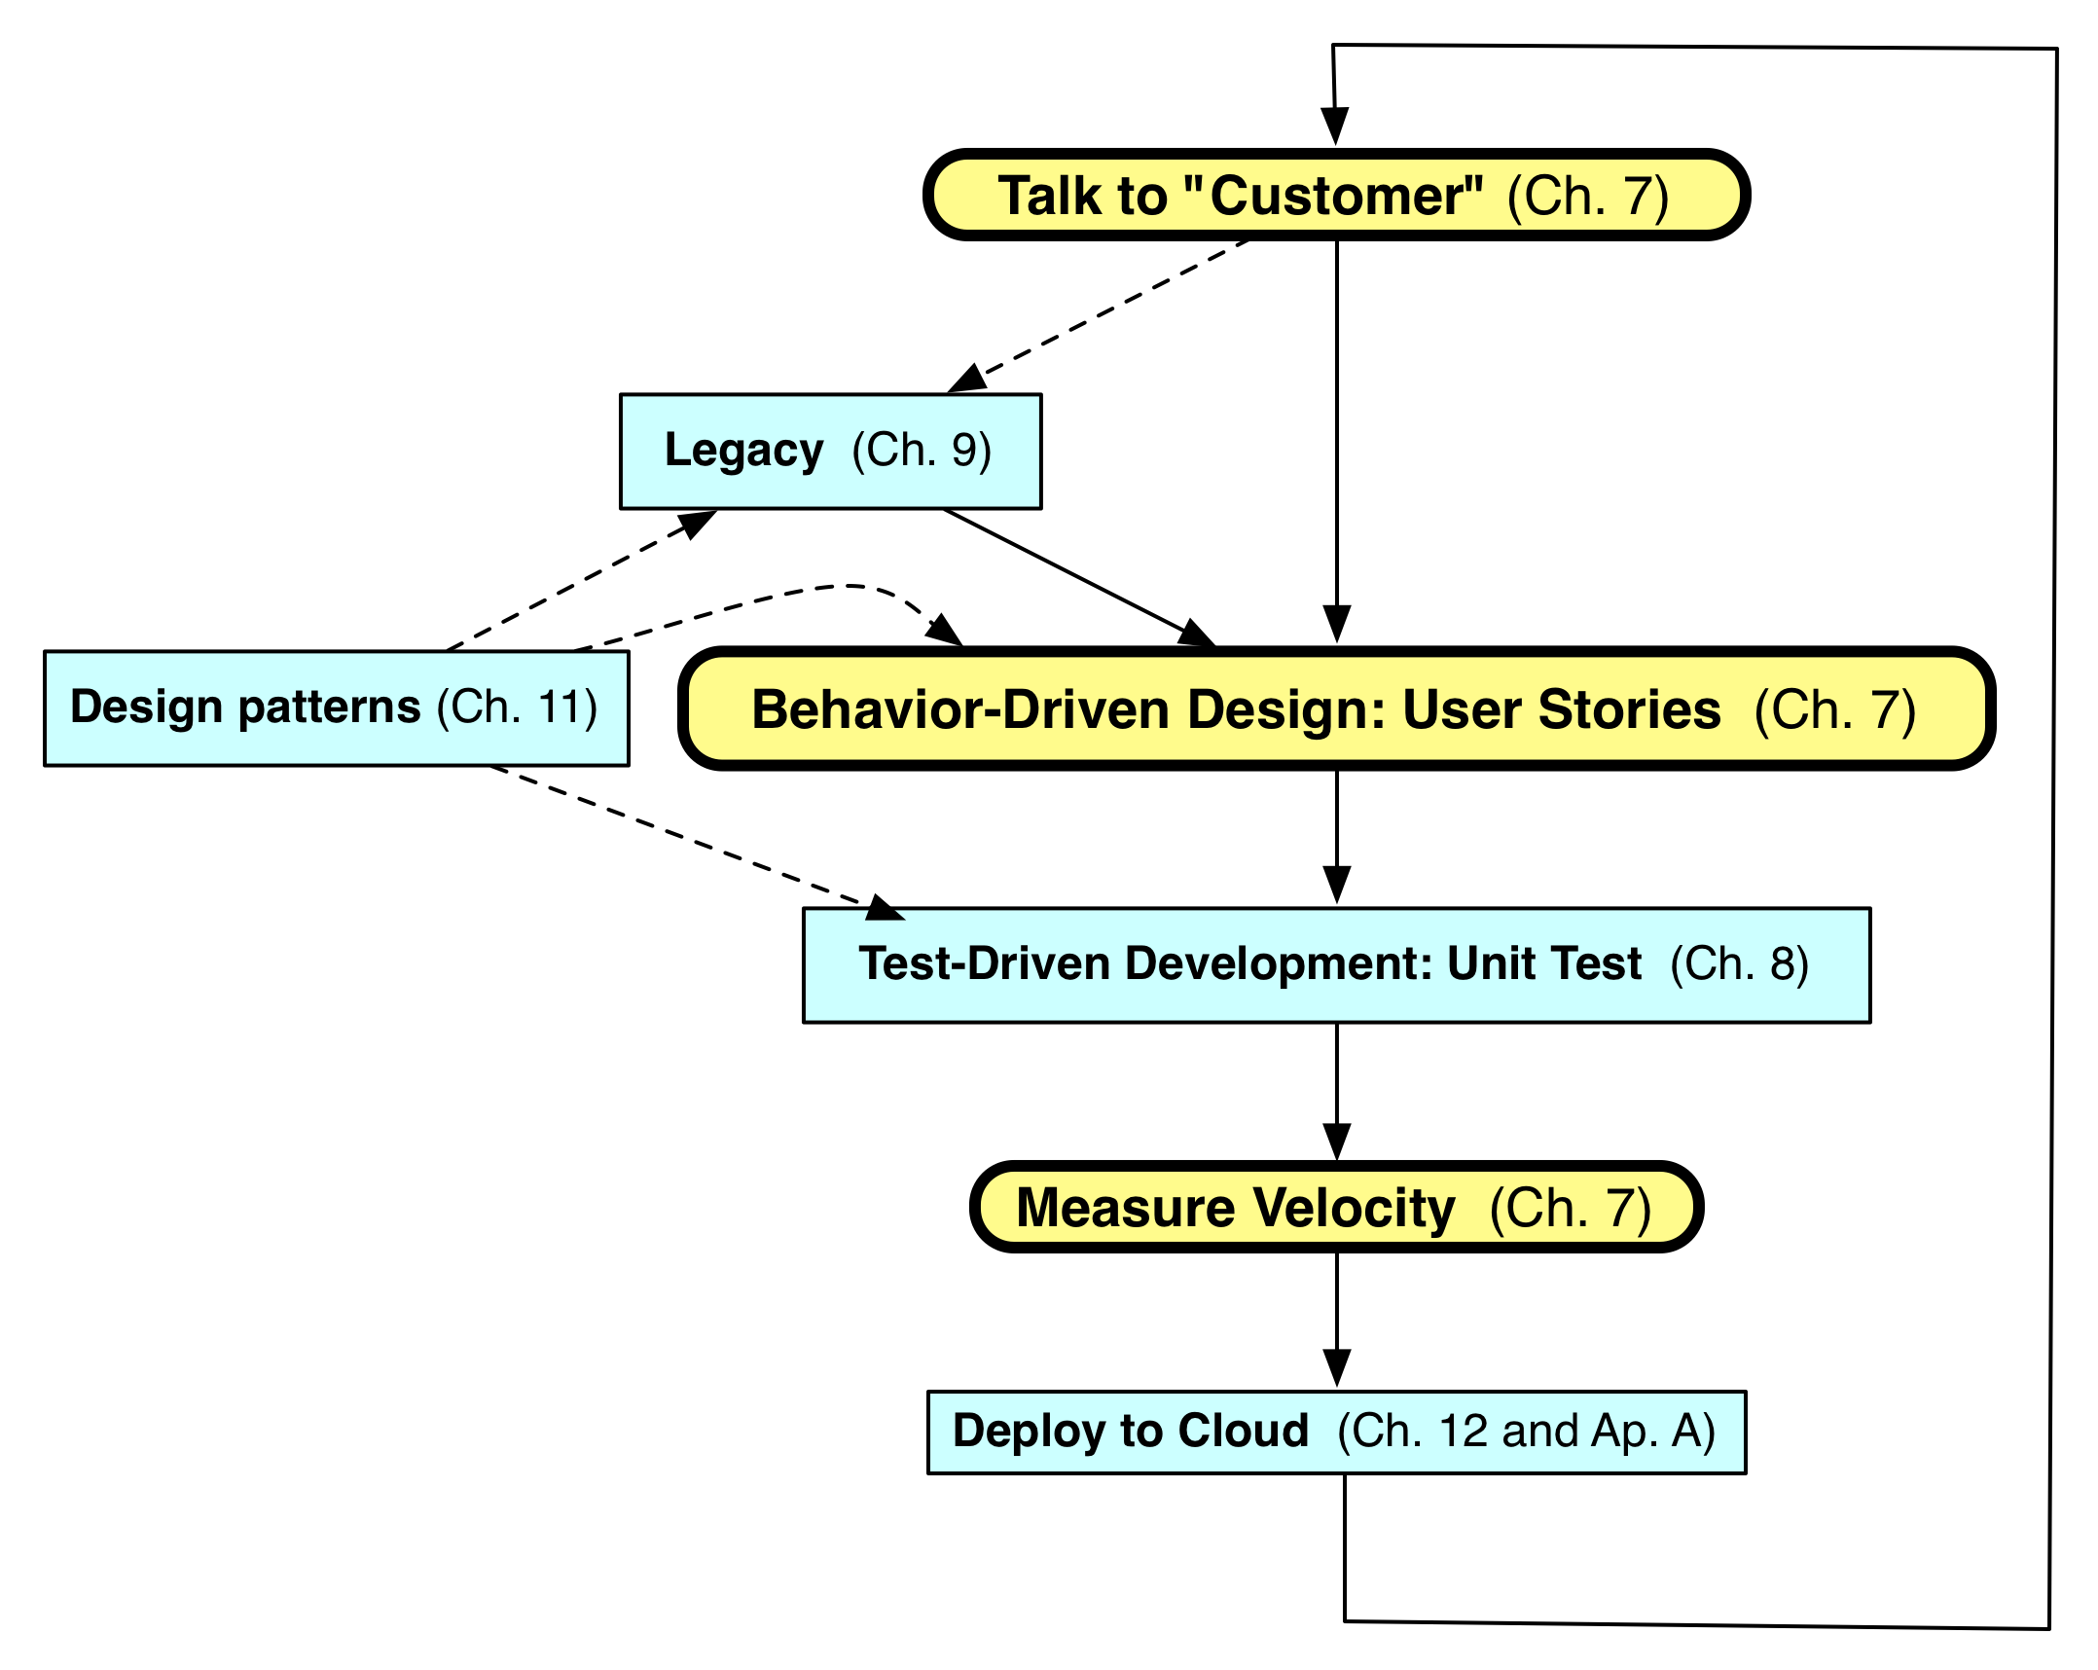
Agile Iteration

Slide 26
Behavior-Driven Design (BDD)
BDD asks questions about behavior of app before and during development to reduce miscommunication
Validation vs. Verification
Requirements written down as user stories
Lightweight descriptions of how app used
BDD concentrates on behavior of app vs. implementation of app
Test Driven Design or TDD (future segments) tests implementation

Slide 27
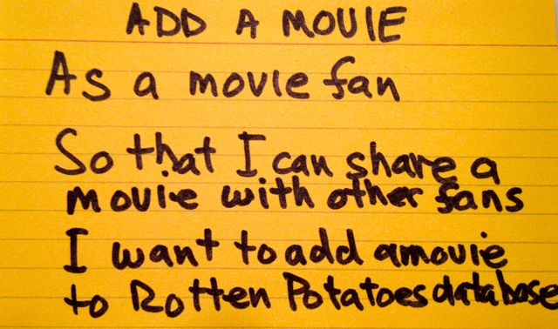
User Stories
1-3 sentences in everyday language
Fits on 3” x 5” index card
Written by/with customer
“Connextra” format:
Feature name
As a [kind of stakeholder], So that [I can achieve some goal], I want to [do some task]
3 phrases must be there, can be in any order
Idea: user story can be formulated as acceptance test before code is written
Notes:
Dave Patterson created this image
Ideas from CHI community

Slide 28
Why 3x5 Cards?
(from User Interface community)
Nonthreatening => all stakeholders participate in brainstorming
Easy to rearrange => all stakeholders participate in prioritization
Since stories must be short, easy to change during development
Often get new insights during development

Slide 29
Different Stakeholders May Describe Behavior Differently
See which of my friends are going to a show
As a theatergoer
So that I can enjoy the show with my friends
I want to see which of my Facebook friends are attending a given show
Show patron’s Facebook friends
As a box office manager
So that I can induce a patron to buy a ticket
I want to show her which of her Facebook friends are going to a given show

Slide 30
Product Backlog
Real systems have 100s of user stories
Backlog: User Stories not yet completed
(We’ll see Backlog again with Pivotal Tracker)
Prioritize so most valuable items highest
Organize so they match SW releases over time

Slide 31
Related Issue
Spike
Short investigation into technique or problem
E.g. spike on recommendation algorithms
After spike done, code must be thrown away
Now know approach you want, write it correctly
Not all code branches merge into production

Slide 32
END

Slide 33
Which expression statement regarding BDD and user stories is FALSE?
1.
BDD is designed to help with validation (build the right thing) in addition to verification
2.
BDD should test app implementation
3.
User stories in BDD play same role as design requirements in Plan-and-Document
4.
This is a valid User Story: “Search TMDb
I want to search TMDb As a movie fan So that I can more easily find info”
Notes:
1. True. We will turn behaviors into acceptance tests.
2. False. BDD tests system behavior, not implementation.
3. True. User stories are the BDD requirements.
4. True. It includes the stakeholder, goal and task.

Slide 34
END

Slide 35

Points, Velocity, and Pivotal Tracker (Engineering Software as a Service §7.2)
© 2013 David Patterson & David Patterson
Licensed under Creative Commons Attribution-NonCommercial-ShareAlike 3.0 Unported License

Slide 36
Productivity and Tools
Don’t we want to avoid major planning effort in Agile? If so, how to estimate time without a plan?
Can User Stories be used to measure progress on project?
What should a tool do to help measure progress for Agile?

Slide 37

Measuring Productivity
A measure of team productivity: calculate avg. no. stories / week?
But some stories much harder than others
Rate each user story in advance on a simple integer scale
1 for straightforward, 2 for medium, 3 for very complex
Velocity: avg. number of points / week
Notes:
Start with this 3 point scale
Why good idea?
See what you actually accomplish in points per week vs. what you guess as optimistic programmers
Teams learns to get estimate difficulty of user story (gave a story 1 point but took 2 weeks; why was it hard? Learn from mistakes)

Slide 38

More on Points
Once get experience, Fibonnaci scale is commonly used: 1, 2, 3, 5, 8
(Each new number is sum of previous 2)
At Pivotal Labs, 8 is extremely rare
Teams assign value: vote by holding up fingers simultaneously, take average
If a big disagreement (2 and 5), discuss more
Notes:
How decide points – rock, paper, scissors – everyone says how many points a story is, and see if agree
Go with average, but record each opinions, check later to see how well you did, why are some team members more accurate estimators?

Slide 39
More on Points
≥5 => divide user story into simpler stories
backlog not too demanding
Doesn’t matter if velocity is 5 or 10 points per iteration
As long as team is consistent
Idea is to improve self-evaluation and suggest number of iterations for feature set
Notes:
At Pivotal Labs, break into multiple stories
Every time there is a SW concept, someone builds a tool to implement idea to make it easy to do

Slide 40
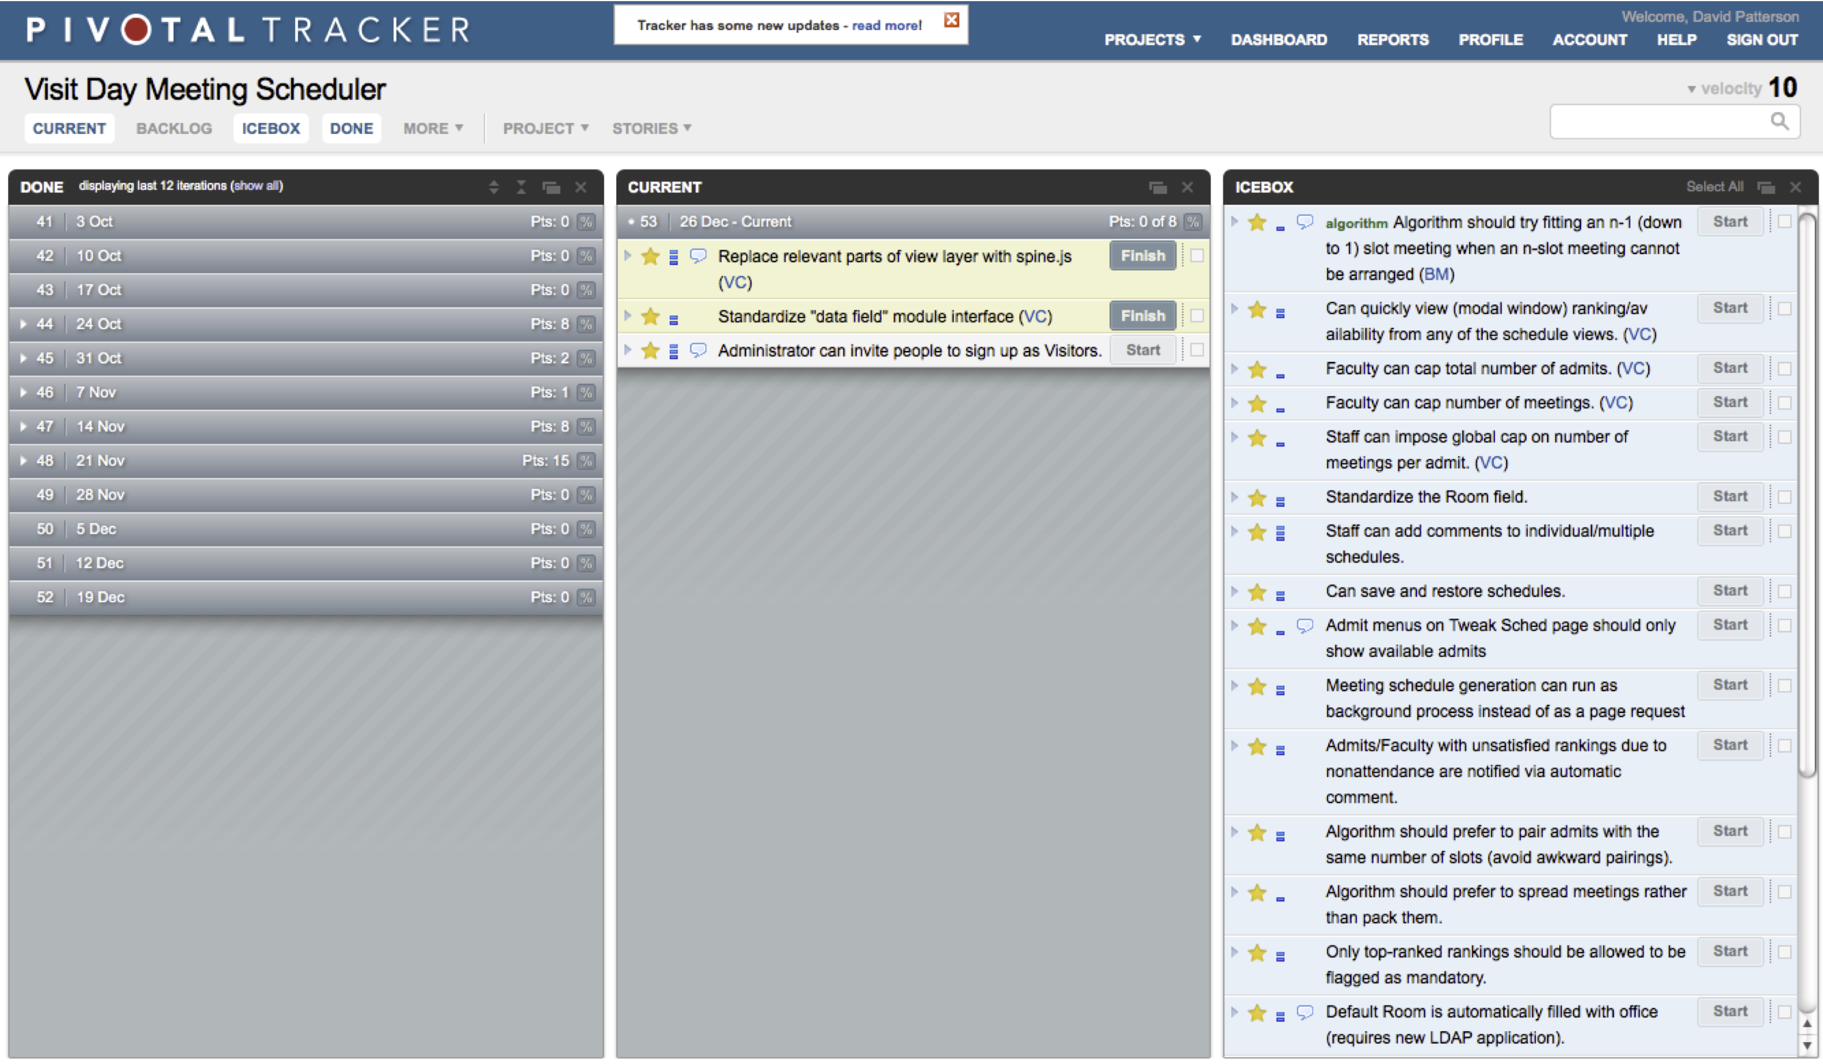
Pivotal Tracker
Calculates velocity for team, manages user stories: Current, Backlog, Icebox
Notes:
Pivotal Labs brought us Pivotal Tracker
Bookkeeping for user stories, as long as doing that, might as well calculate velocity Upper right corner is team velocity (10 in this case)
Very easy to use
Current
Done
Backlog (not shown) – what work on next
Icebox – invent more stories than will ever implement (frozen)
Pivotal will move things from backlog to current automatically and assign people to the tasks
Top to bottom is prioritized order (except in icebox, it is random)

Slide 41
Pivotal Tracker
Prioritize user stories by where place them in Current, Backlog, Icebox panels
When completed, move to Done panel
Can add logical Release points, so can figure out when a Release will really happen
Remaining points/Velocity
Epic (with own panel)
Combine related user stories together
Ordered independent of user story in Backlog
Notes:
Epic: give software engineers the big picture of where the application is in the development process with regard to big feature
Will put into backlog with Release Point
Tracker will estimate when Release Point looks to be
Tell customer as go along

Slide 42
Tracker Roles
Developers don’t decide when user stories completed
Pushes Finish button, which sends to “Product Owner” (as in Scrum team organization)
Product Owner tries out the user story and then either hits
Accept, which marks user story as done, or
Reject, which marks story as needing to be Restarted by developer
Notes:
Follow scrum roles, Product owner signs off

Slide 43
Pivotal Tracker: Features vs. Chores
Features
User stories that provide verifiable business value to customer
“Add agree box to checkout page”
Worth points & therefore must be estimated
Chores
User Stories that are necessary, but provide no direct, obvious value to customer
“Find out why test suite is so slow”
No points

Slide 44
Team Cyberspace Whiteboard
Tracker allows attaching documents to User stories (e.g., LoFi UI)
Wiki with Github repository
Google Documents: joint creation and viewing of drawings, presentations, spreadsheets, and text documents
Campfire: web-based service for password-protected online chat rooms

Slide 45
END

Slide 46
Which expression statement regarding Points, Velocity, and Tracker is TRUE?
1.
When comparing two teams, the one with the higher velocity is more productive
2.
When you don’t know how to approach a given user story, just give it 3 points
3.
With Tracker, developers pick the user stories and mark as Accepted when done
4.
Tracker helps prioritize and keep track of user stories and their status, calculates velocity, and predicts software development time
Notes:
1. False. Since each team assigns points to user stories, you cannot use velocity to compare different teams. However, you could look at a given team over time to see if there were some iterations that were significantly less or more productive
2. False. User stories should not be so complex that you don’t know have an approach to implementing it. If they are, you should go back to your stakeholders to refactor the user story into a set of simpler tasks that you do know how to approach
3. False. Product owners say when done, not developers
4. True.
Velocity is self-assessment
Not supposed to not know what you’re doing

Slide 47
END

Slide 48
SMART User Stories (Engineering Software as a Service §7.3)
© 2013 David Patterson & David Patterson
Licensed under Creative Commons Attribution-NonCommercial-ShareAlike 3.0 Unported License

Slide 49
Creating User Stories
How do you know if you have a good user story vs. bad user story?
Right size?
Not too hard?
Is worthwhile?

Slide 50
SMART Stories
Specific
Measurable
Achievable (ideally, implement in 1 iteration)
Relevant (“the 5 why’s”)
Timeboxed (know when to give up)

Slide 51

Specific & Measurable
Each scenario testable
Implies known good input and expected results exist
Anti-example: “UI should be user-friendly”
Example: Given/When/Then
Given some specific starting condition(s),
When I do X,
Then one or more specific thing(s) should happen

Slide 52

Achievable
Complete in 1 iteration
If can’t deliver feature in 1 iteration, deliver subset of stories
Always aim for working code @ end of iteration
If <1 story per iteration, need to improve point estimation per story

Slide 53
Relevant: “Business Value”
Discover business value, or kill the story:
Protect revenue
Increase revenue
Manage cost
Increase brand value
Making the product remarkable
Providing more value to your customers

Slide 54
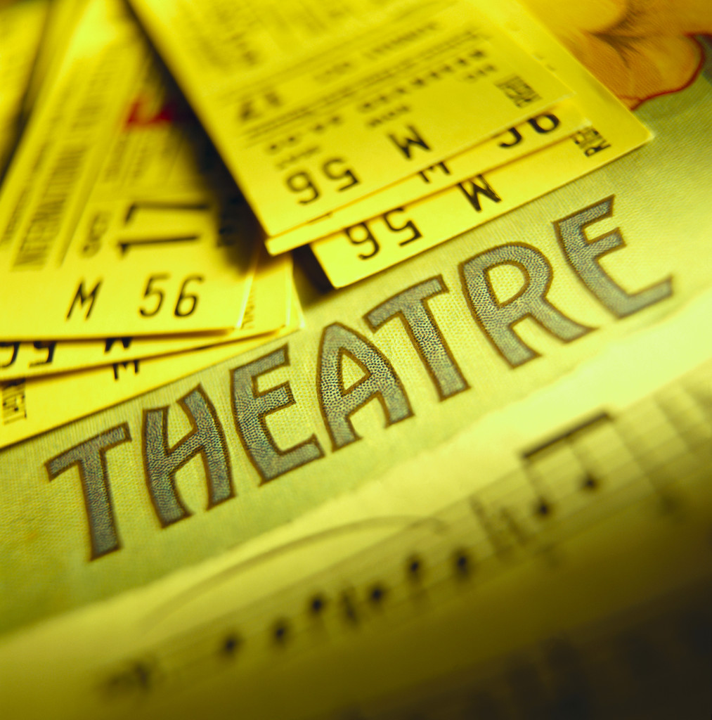
5 Whys to Find Relevance
Show patron’s Facebook friends
As a box office manager
So that I can induce a patron to buy a ticket
I want to show her which Facebook friends are going to a given show
Why?
Why?
Why?
Why?
Why?
Notes:
Why add the Facebook feature? As box office manager, I think more people will go with friends and enjoy the show more.
Why does it matter if they enjoy the show more? I think we will sell more tickets.
Why do you want to sell more tickets? Because then the theater makes more money.
Why does theater want to make more money? We want to make more money so that we don’t go out of business.
Why does it matter that theater is in business next year? If not, I have no job.

Slide 55

Timeboxed
Stop story when exceed time budget
Give up or divide into smaller stories or reschedule what is left undone
To avoid underestimating length of project
Pivotal Tracker tracks velocity, helps avoid underestimate

Slide 56
END

Slide 57
Which feature below is LEAST SMART?
1.
User can search for a movie by title
2.
Rotten Potatoes should have good response time
3.
When adding a movie, 99% of Add Movie pages should appear within 3 seconds
4.
As a customer, I want to see the top 10 movies sold, listed by price, so that I can buy the cheapest ones first
Notes:
1. Covers all of SMART aspects.
2. Least SMART, no quantitative metric, e.g. response time < 3 seconds
3. Covers all of SMART aspects.
4. Covers all of SMART aspects.

Slide 58
END

Slide 59
Lo-Fi UI Sketches and Storyboards (Engineering Software as a Service §7.4)
© 2012 David Patterson & David Patterson
Licensed under Creative Commons Attribution-NonCommercial-ShareAlike 3.0 Unported License

Slide 60
Building Successful UI
SaaS app often faces users
User stories need User Interface (UI)
How to get customer to participate in UI design so is happy when complete?
Avoid WISBNWIW* UI
UI version of 3x5 cards?
How to show UI interactivity without building a prototype?
*What-I-Said-But-Not-What-I-Want

Slide 61

SaaS User Interface Design
UI Sketches: pen and paper drawings or “Lo-Fi UI”

Slide 62
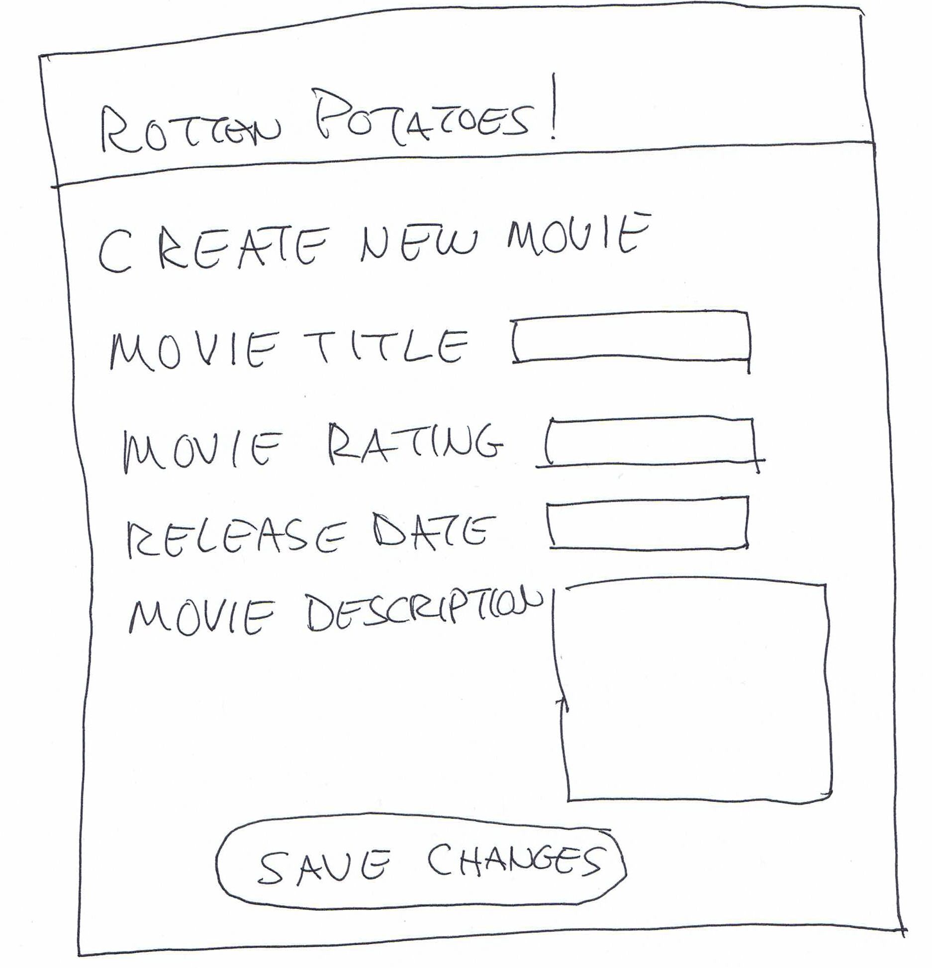
Lo-Fi UI Example
(Figure 7.3, Engineering Long Lasting Software by Armando Fox and David Patterson, 1st edition, 2014.)

Slide 63
Storyboards
Need to show how UI changes based on user actions
HCI => “storyboards”
Like scenes in a movie
But not linear

Slide 64
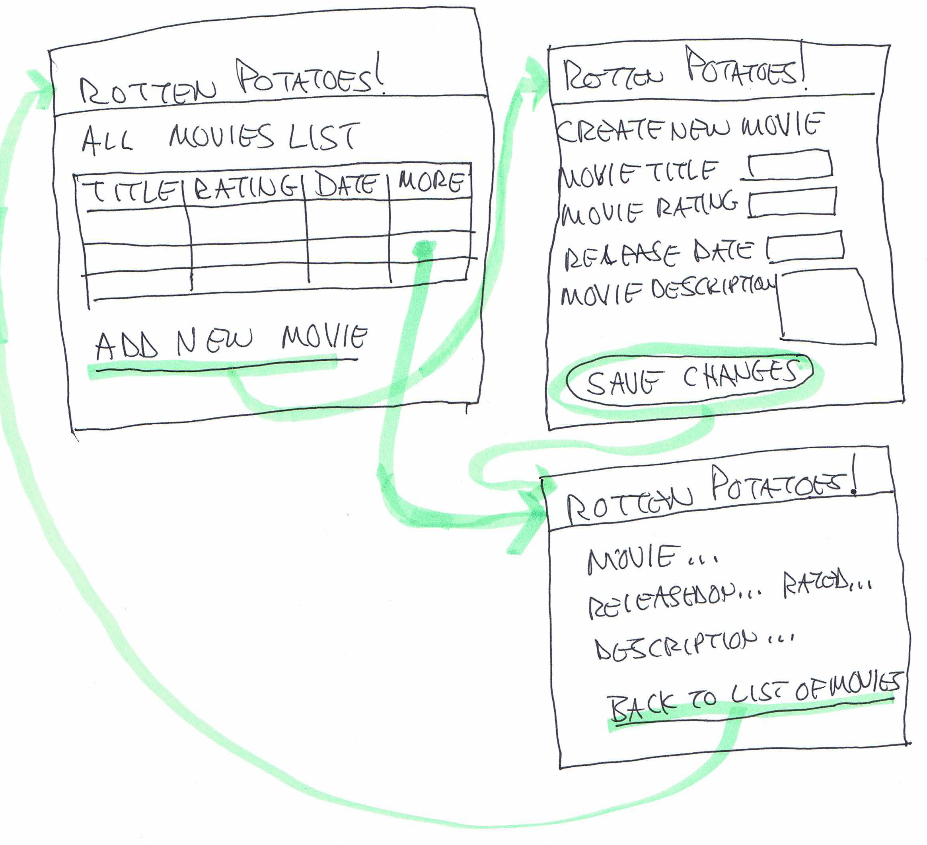
Example Storyboard
(Figure 7.4, Engineering Long Lasting Software by Armando Fox and David Patterson, 1st edition, 2014.)

Slide 65
Lo-Fi to HTML
Tedious to do sketches and storyboards, but easier than producing HTML!
Also less intimidating to nontechnical stakeholders => More likely to suggest changes to UI if not code behind it
More likely to be happy with ultimate UI
Next steps: CSS (Cascading Style Sheets) and Haml (later)
Make it pretty after it works

Slide 66
END

Slide 67
Which is FALSE about Lo-Fi UI?
☐
Like 3x5 cards, sketches and storyboards are more likely to involve all stakeholders vs. code
☐
The purpose of the Lo-Fi UI approach is to debug the UI before you program it
☐
SaaS apps usually have user interfaces associated with the user stories
☐
While it takes more time than building a prototype UI in CSS and Haml, the Lo-Fi approach is more likely to lead to a UI that customers like
Notes:
1. True. Easy to change, so more people willing to give inputs.
2. True. Get all of the views, view elements and view relationships correct before coding.
3. True. A user story talks about interacting with the system, therefore there must be a UI.
4. False. Lo-Fi takes less time than building a prototype.

Slide 68
END

Slide 69
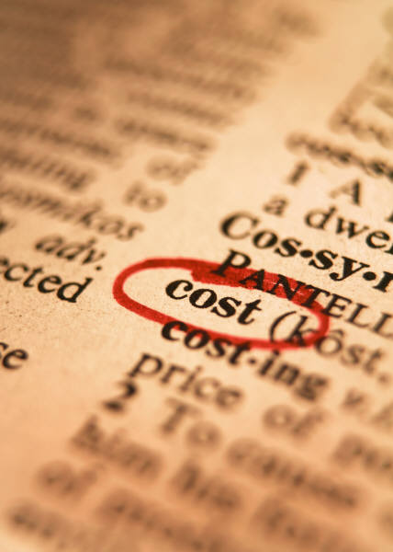
Agile Cost Estimation (Engineering Software as a Service §7.5)
© 2013 David Patterson & David Patterson
Licensed under Creative Commons Attribution-NonCommercial-ShareAlike 3.0 Unported License

Slide 70
Agile Cost Estimation
Real world needs to estimate cost before customer can agree to project
If no careful planning and schedule in Agile, how can you estimate the cost of a project?

Slide 71
Pivotal Labs Model
Pivotal Labs teaches customer Agile
Using Agile, Pivotal never commits to delivering features X, Y, and Z by date D
Instead, commits resources to work in the most efficient way possible up to date D
Customer works with team to define priorities continuously up to date D
Still need estimate for project

Slide 72
Pivotal Labs Agile Estimate
1 hour phone call to explain method
Joint effort, customer time commitment, …
Customer visits for 1.5 hour “scoping”
Customer brings designer, developer, designs
Anything to clarify what customer wants done
Pivotal brings 2 engineers who ask questions
Trying to identify what adds uncertainty to estimate
Engineers take ½ hour to estimate weeks
Little vs. large uncertainty: 20-22 vs. 18-26 wks
Bid cost as time and materials to customer

Slide 73
END

Slide 74
Which expression statement regarding cost estimation is TRUE? (PL = Pivotal Labs)
1.
As practitioners of Agile Development, PL does not use contracts
2.
As practitioners of pair programming, PL estimates cost for 1 pair, which it assigns to complete project
3.
The cost bid is for PL time and materials that covers number of weeks in the estimate
4.
As studies show 84%-90% projects are on-time and on-budget, plan-and-document managers promise customers a set of features for an agreed upon cost by an agreed upon date
Notes:
1. False. Pivotal offers customers a contract that they sign, but it is primarily a promise to pay Pivotal for its best effort over to make the customer happy for a limited range of time.
2. False. A project may have multiple pairs, depending on the most efficient team size for the project.
3. True. Project bids are based on the estimated cost per week and number of weeks.
4. False. – 84% to 90% of projects are late and/or over budget

Slide 75
END

Slide 76
Plan-And-Document Perspective (Engineering Software as a Service §7.10)
© 2013 David Patterson & David Patterson
Licensed under Creative Commons Attribution-NonCommercial-ShareAlike 3.0 Unported License

Slide 77
Introduction
What does Plan-and-Document do instead of:
User stories?
Points?
Velocity?
How does a project manager estimate costs? Make a schedule?

Slide 78
P&D Equivalents+
Requirements Elicitation
Requirements Documentation
Cost Estimation
Scheduling & Monitoring Progress
Change Management for Requirements, Cost, &Schedule
Ensuring Implementation Matches Requirement Features
Risk Analysis & Management
Notes:
1-4 at start of Waterfall, at start of Spiral/RUP iterations
5-6 deal with changing requirements over time
7 needed for P&D, but not BDD

Slide 79
P&D Requirements Elicitation
Elicit functional&non-functional requirements:
Interviewing - see how currently really done
Stakeholders answer predefined questions
Or just have informal discussions
Cooperatively create Scenarios
Initial state, show flow for happy & sad paths, what is concurrent, final state
Create Use Cases
List of steps to achieve goal between user and system; has language (UML) to describe
Notes:
Functional – features, “add a movie”
Non-functional – performance goal (eg/. 99% responses) < 1 sec; dependability goal (4 9s); security
UML – Unified Modeling Language

Slide 80

P&D Requirements Documentation
Document requirements via Software Requirements Specification (SRS)
100s of pages; IEEE 830-1998 std for SRS!
Have stakeholders read SRS, or build basic prototype, or generate test cases to check:
Validity: are all requirements necessary?
Consistency: do requirements conflict?
Completeness: are all requirements and constraints included?
Feasibility: can requirements be implemented?

Slide 81
P&D Cost Estimation
Manager decomposes SRS into tasks
Estimates weeks per task
1 week ≤ Tasks ≤ 8 weeks
Covert person-weeks into $ via salaries and overhead
Estimate before & after contract
Add safety margin: 1.3 to 1.5X
Make 3 estimates (best case, expected, worst) then make best guess

Slide 82
P&D Cost Estimation
Experiential Estimate
Rely on manager’s experience to be accurate
Quantitative Estimate
Estimate tasks in lines of code (LOC), divide by LOC/person-month
COCOMO (Constructive Cost Model): Effort = OrgFactor ⋅ CodeSize^{Penalty} ⋅ ProdFactor
Organization Factor = 2.94, 1.10≤SizePenalty≤1.24, 0.90 ≤ Product Factor ≤1.40
92% use experiential, not formula

Slide 83
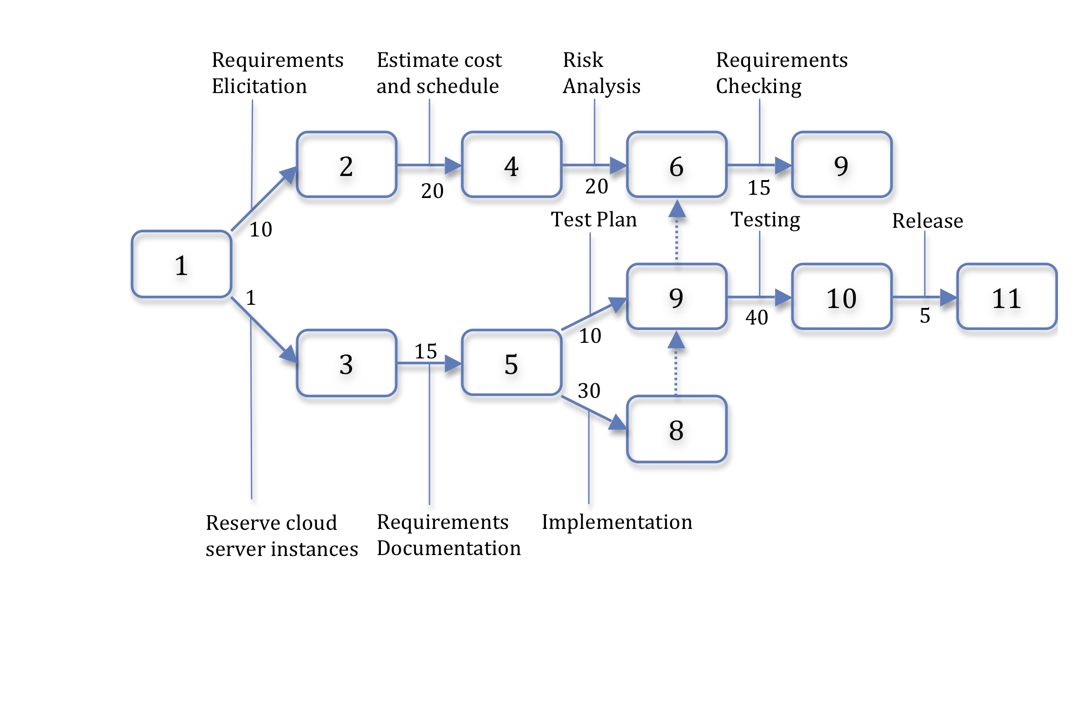
P&D Scheduling
Use PERT chart to show task parallelism and critical path to make schedule
Nodes are milestones, link names are tasks, link numbers are effort, arrows are dependencies
Notes:
PERT – program/project evaluation and review technique, finds longest path through directed acyclic graph (DAG)

Slide 84
P&D Monitoring Progress
Compare predicted to actual
Time for tasks
Expenditures
Intermediate milestone help all stakeholders see if project is on schedule & on budget

Slide 85
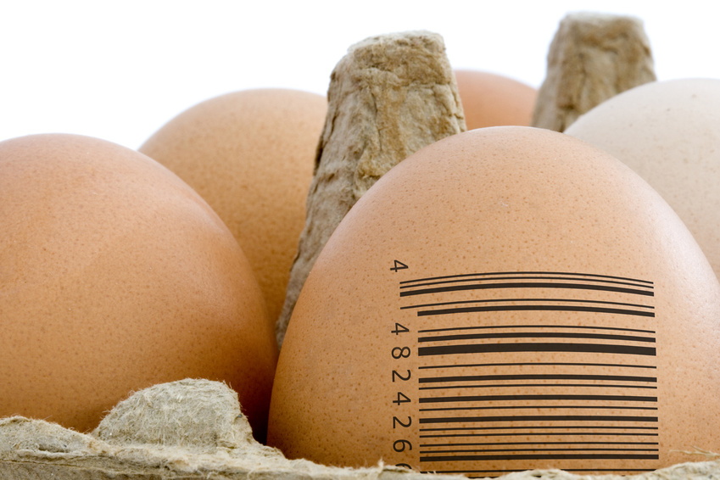
P&D Requirements Checking
Manager uses tools for requirements traceability
Tool has cross references between
Portion of SRS with requirement
Portion of code that implements requirement
Tests that validate requirement

Slide 86

P&D Risk Analysis & Management
To improve accuracy of budget/schedule
Identify risks early to
Do extra work to reduce risk
Change plan to avoid risk
Technical: RDB can’t scale
Organizational: J2EE???
Business: too late for market
Create Risk Table: % chance x impact
Address top 20%, hoping 80% of risk
Notes:
J2EE – Java 2 Platform – Enterprise Edition
RDB – relational database

Slide 87
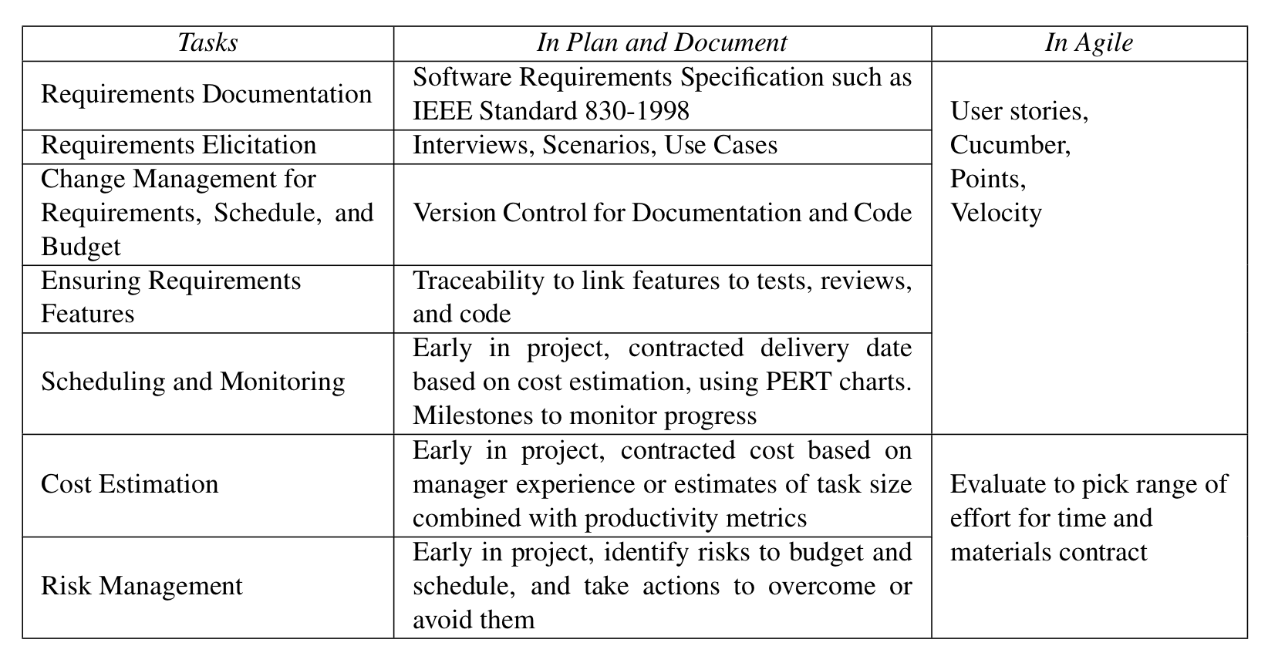
P&D vs. Agile Requirements and Schedule/Cost Estimation

Slide 88
END

Slide 89
Which statement regarding P&D requirements and cost estimation is FALSE?
1.
The closest to the P&D schedule and monitoring tasks are Agile points and velocity
2.
The closest to the P&D Software Requirements Specification (SRS) document is Agile User Stories
3.
Agile has no equivalent to ensuring requirements, such as traceability
4.
P&D requires risk analysis, while Agile does not
Notes:
1. True.
2. True.
3. False. Agile ensures requirements via Behavior Driven Design by turning user stories into acceptance tests
4. True.

Slide 90
END

Slide 91
And in Conclusion: §§9.4-9.5, 7.1-7.5, 7.10
SOFA methods: Short, do One thing, Few arguments, consistent Abstraction
Metrics point to problem code
BDD: User stories to elicit requirements
SMART: Specific, Measureable, Achievable, Relevant, Timeboxed
Points/Velocity to calculate progress (Tracker)
Lo-Fi UI/storyboard: sketch to elicit UI design
Lifecycles: Plan&Document (careful planning & documentation) v. Agile (embrace change)

